Slide 1

An Assignment
of
Time Series Forecasting (in R)

Slide 2
Team
Under the supervision
of:-
Prof. Sridhar Srinivasan
Team:-
Mohd Arshan(E20015)
Indrajit Singh(E20012)
Satyam Rastogi(E20030)
Shantam Kar(E20031)

Slide 3
Agenda
01
Anomaly detection
Data:- Electricity Consumption
Library :- Twitter/anomaly detection
02
Missing Value Imputation
Data :- tsAirGap
Library :- imputeTS
03
AR, MA, ARMA, ARIMA,SARIMA
Data:- US Vehicle Sales, Tractor sales
Library:- tseries, forecast
04
ARIMAX, SARIMAX
Get a modern PowerPoint Presentation.

Slide 4
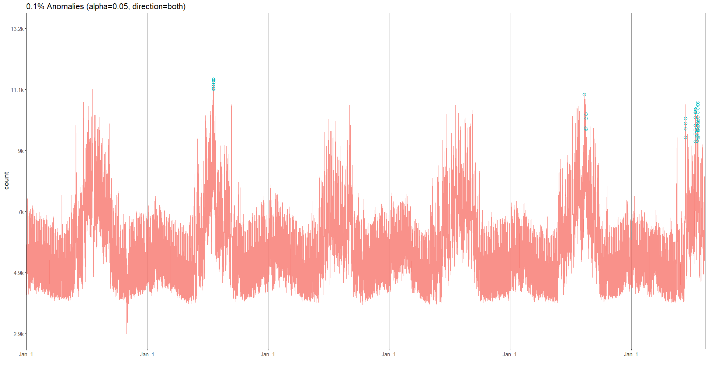
Anomaly Detection
0.1%
49 rows
Library
Twitter /
Anolmaly detection

Slide 5
Missing Value Imputation
Data :- tsAirgap
90%
Library:- library("imputeTS")
80%
Methods:-
na.mean
na.interpolate
na.locf
na_ma
Seasonal Adjustment-Used when we have seasonality in the data
na_seadec
60%
45%
30%
Method 1
Method 2
Method 3
Method 4
Method 5

Slide 6
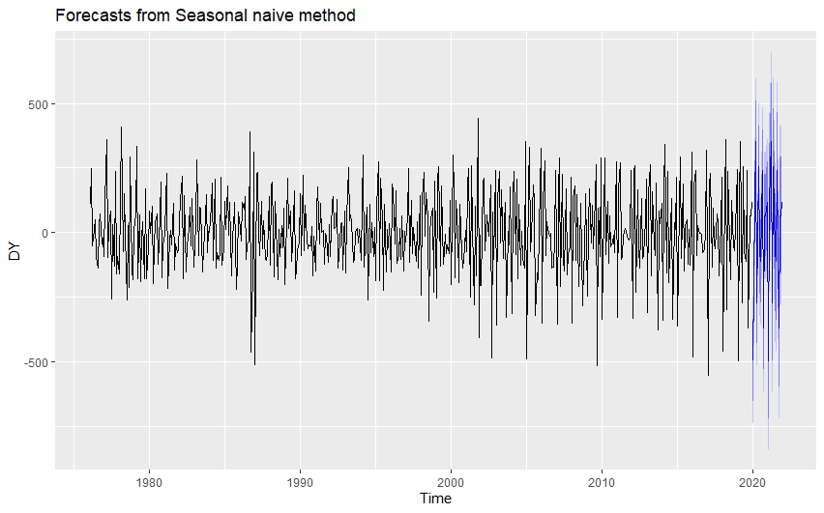
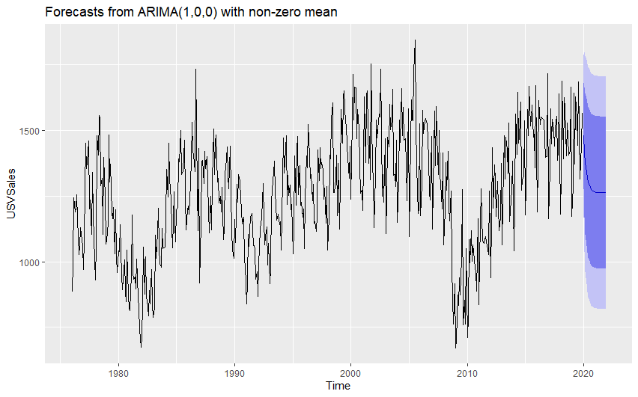
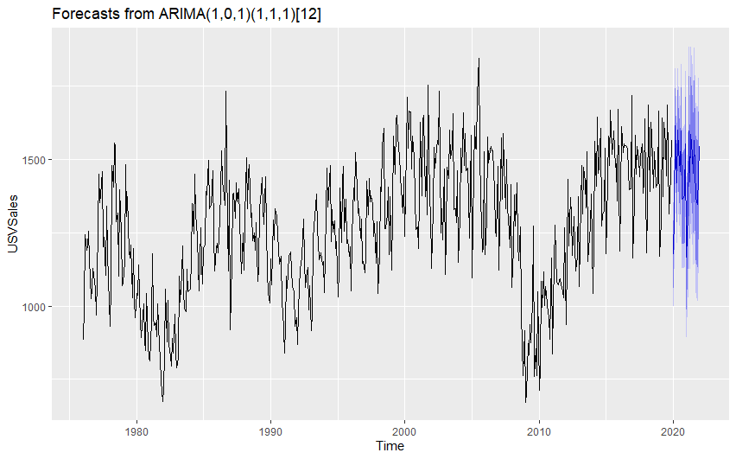
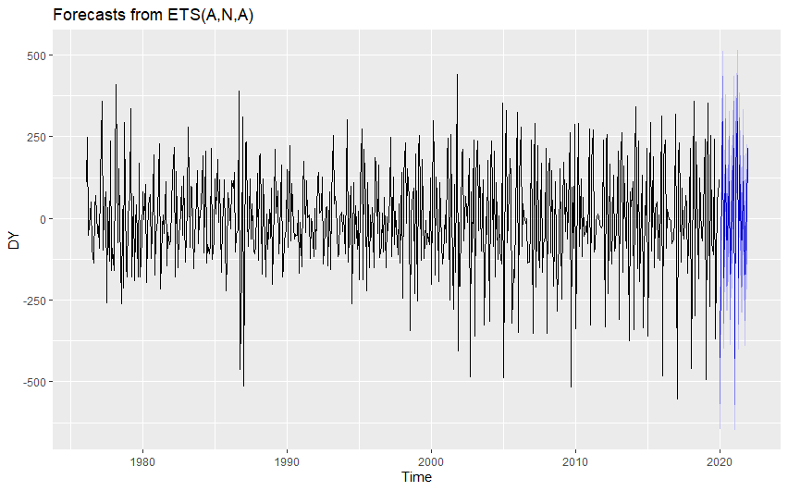
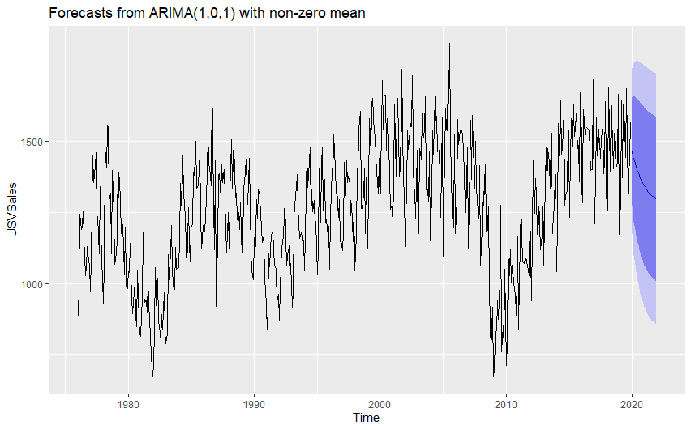
ARIMA(p,d,q)
snaive
AR & MA
ARIMA & SARIMA
ETS
ARMA(1,0,1)

Slide 7
Arimax – Autoregressive Intergrated Moving Average Sarimax – Same as Arimax With persence of Seasonality X-Exogenous Variable a factor in the model whose value is identified by the factors of the variables outside model of study For ex. In farming, Production forecast is based on factors like area of land quality of seed etc. But in this rainfall is an exogenous variable whose value will be determined by the other factors like Humidity, air speed etc.(All being Exogenous variable)

Slide 8
Thank You

